Slide 1
ANOVA Procedure

Slide 2
ANOVA Procedure
When do we need a ANOVA procedure?
When we need to analyze the balanced data from a wide variety of experimental designs.
What does the ANOVA procedure does?
Produce analysis of variance table
Produce the means and the comparison of the means for any effect
Produce multivariate statistics

Slide 3
ANOVA Procedure
Which statements are included in an ANOVA procedure?
FORMAT:
<1>
PROC ANOVA option;
CLASS variable names;
MODEL response variables = effects / options; MEANS effects / options;
FREQ variable name;
TEST H = effects E = effect;
MANOVA H = effects E = effect / options;
BY variable names;
<2>
<3>
<4>
<5>
<6>
<7>
<8>
Required statement: 1,2,3
Optional statements: 4 , 5, 6, 7, 8

Slide 4
ANOVA Procedure
SPECIFICATIONS:
<1>
PROC ANOVA option;
The ANOVA procedure begins with a PROC ANOVA statement. The options that may appear in the statement are:
DATA= dsn
Gives the name of the SAS data set to be used in the procedure. If it is omitted, the last SAS data set created will be used.

Slide 5
MANOVA
Requests the multivariate mode of eliminating observations with missing values. If any of the dependent variables have missing values, the procedure eliminates that observation from the analysis. The MANOVA option is useful if we use ANOVA procedure in interactive mode and plan to perform a multivariate analysis.
NOPRINT
Suppresses the normal display of results. The NOPRINT option is useful when we want to create only the output data set with the procedure.

Slide 6
ORDER=keyword
Specifies the sort order for the levels of the classification variables. The keyword to be used are:
DATA
Order of appearance in the input data set.
FORMATTED
External formatted value, except for numeric variables with no explicit format, which are sorted by their unformatted (internal) value.
FREQ
Descending frequency count; levels with the most observations come first in the order.
INTERNAL
Unformatted value.
ORDER=FORMATTED is the default.

Slide 7
OUTSTAT= dsn
Names an output data set that contains sums of squares, degrees of freedom, F statistics, and probability levels for each effect in the model.

Slide 8
ANOVA Procedure
SPECIFICATIONS:
<2>
CLASS variable names;
The CLASS statement declares classification variables to be used in analysis. The CLASS statement must appear before the MODEL statement.

Slide 9
ANOVA Procedure
SPECIFICATIONS:
<3>
MODEL response variables = effects / options;
The MODEL statement defines the statistical model to be analyzed. After the keyword MODEL, the response (dependent) variables are specified, followed by an equal sign and the list of effects. For example, the following statements:
PROC ANOVA;
CLASS Trt Blk;
MODEL Y = Trt Blk;
indicate Y as response variable, Trt and Blk as main effects (a two-factor main effects statistical model with Trt and Blk as the factors).

Slide 10
The interaction effects are specified by joining the effects with asterisks.
For example, the following statements:
PROC ANOVA;
CLASS Trt Blk;
MODEL Y = Trt Blk Trt*Blk;
indicate Y as response variable, Trt and Blk as main effects, and Trt*Blk as interaction effect of Trt and Blk.

Slide 11
We can shorten of a full factorial model by using bar ( | ) notation.
For example, the following MODEL statement:
MODEL Y = A|B|C;
is equivalent to the following MODEL statement:
MODEL Y = A B C A*B A*C B*C A*B*C;
We can also specify the maximum number of variables involved in any effect that results from bar evaluation by specifying that maximum number, preceded by an @ sign, at the end of the bar effect. For example, the specification A | B | C@2 results in only those effects that contain two or fewer variables; in this case, A B A*B C A*C and B*C.

Slide 12
Nested effects are specified by following a main effect or crossed effect with a effect or effects enclosed in parentheses in the MODEL statement. The identity of a level is viewed within the context of the level of the containing effects. For example, if City is nested within State, then the identity of City is viewed within the context of State.
There is no difference between the statements
MODEL Y = A B(A);
and
MODEL Y = A A*B;

Slide 13
Asterisks and parentheses can be combined in the MODEL statement for models involving nested and crossed effects:
PROC ANOVA;
CLASS A B C;
MODEL Y = A B(A) C(A) B*C(A);
All variables in effects that we specify in the MODEL statement must appear in the CLASS statement.

Slide 14
If any options are used, they follow a slash in the statement. A slash is not needed if no options are specified. The options that may appear in the statement are:
NOUNI
Requests that the univariate analysis not be printed that are produced by default.
INT
Requests that the hypothesis test associated with the intercept. The model always includes the intercept but by default prints no associated tests of hypotheses.

Slide 15
ANOVA Procedure
SPECIFICATIONS:
<4>
MEANS effects / options;
A MEANS statement is used to request that means of each level of listing effects be printed and compared. Any effect appears in the MEANS statement must also appears in the MODEL statement. We can use any number of MEANS statements, provided that the effects appear in the MODEL statement.

Slide 16
For example, the following statements:
PROC ANOVA;
CLASS Trt Blk;
MODEL Y = Trt Blk Trt*Blk;
MEANS A B / DUNCAN;
MEANS A*B;
will produce means and standard deviations for each level of the main effects Trt and Blk and each level of interaction effects of Trt and Blk and also produce Duncan multiple comparison tests for each level of the main effects Trt and Blk.

Slide 17
If any options are used, they follow a slash in the statement. The options that may appear in the statement are:
ALPHA = p
Gives the level of significance for comparisons among the means. The default is 0.05. With the DUNCAN option, 0.1, 0.05, 0.01 are the only values we may specify.
BON
PerformsBonferroni t tests of differences between means for all main-effect means in the MEANS statement.
CLDIFF
Presents results of the BON , SCHEFFE , T , and TUKEY options as confidence intervals for all pairwise differences between means, and the results of the DUNNETT option as confidence intervals for differences with the control. The CLDIFF option is the default for unequal cell sizes unless the DUNCAN or SNK option is specified.

Slide 18
CLM
Presents results of the BON , SCHEFFE, and T options as intervals for the mean of each level of the variables specified in the MEANS statement. For all options, the intervals are confidence intervals for the true means.
DUNCAN
Performs Duncan multiple-range test on all main effect means given in the MEANS statements.

Slide 19
DUNNETT(control-values)
Performs Dunnett’s two-tailed t test, testing if any treatments are significantly different from a single control for all main effects means in the MEANS statement. To specify which level of the effect is the control, enclose the formatted value in quotes in parentheses after the keyword. For examples, the statement:
MEANS Trt / DUNNETT('T0');
will request a comparison of each level of the Trt with the control effect T0.

Slide 20
If more than one effect is specified in the MEANS statement, we can use a list of control values within the parentheses. For example, the statement
MEANS A B / DUNNETT('A1' 'B0');
will request a comparison of each level of the A with the control effect A1 and a comparison of each level of B with control effect B0.
By default, the first level of the effect is used as the control.

Slide 21
E = effect
Specifies the error mean square to be used in multiple comparisons.
SCHEFFE
Performs Scheffe multiple-comparison procedure on all main effect means given in the MEANS statements.
T
Performs pairwise t tests on all main effect means given in the MEANS statements
TUKEY
Performs Tukey studentized range test on all main effect means given in the MEANS statements.

Slide 22
ANOVA Procedure
SPECIFICATIONS:
<5>
FREQ variable name;
When a FREQ statement appears, each observation in the SAS data set is assumed to represent k observations in the calculation, where k is the value of the variable whose name is listed in the statement. If k is not an integer, then only the integer portion is used. If k is less than 1, then a value of zero is assumed.

Slide 23
ANOVA Procedure
SPECIFICATIONS:
<6>
TEST H = effects E = effect;
A TEST statement is used to test hypotheses about the parameters estimated in the preceding model. The keyword “H = effects” specifies which effects are used as hypothesis effects. The keyword “E = effect” specifies one, and only one, effect to be used as the error term.
For example, the following statements:
PROC ANOVA;
CLASS Gender Mj;
MODEL Fexam = Gender Mj Gender*Mj;
TEST H=Gender Mj E=Gender*Mj;
test the effect of Gender and Mj by using Gender and Mj interaction as the error term.

Slide 24
ANOVA Procedure
SPECIFICATIONS:
<7>
MANOVA H = effects E = effect / options;
A MANOVA statement is used to request additional multivariate statistics when the MODEL statement includes more than one response variable. Even we do not want multivariate statistics, we can use the statement to request the multivariate mode of handling missing data. “H =” option specifies which effects in the preceding model are to be used as hypothesis matrices. The “E =” option specifies the error effect. If it is left off, the error matrix from the analysis is used. The options can be appear in the statement after a slash are:
PRINTH
requests that the H matrix associated with each effect specified by the H = be printed.

Slide 25
PRINTE
requests that the E matrix be printed
CANONICAL
requests that a canonical analysis of the H and E matrices be printed. This analysis is similar to that produced by CANDISC procedure

Slide 26
ANOVA Procedure
SPECIFICATIONS:
<8>
BY variable names;
The BY statement may appear with ANOVA procedure if separate analysis for each of the BY groups are requested and the data set has been sorted in the order of the BY variables.

Slide 27
ANOVA Procedure
The PROC ANOVA statement is always accompanied by a CLASS statement and a MODEL statement.
Several MEANS, TEST, or MANOVA statements may appear after MODEL statement.
The CLASS statement must precede the MODEL statement, and FREQ, or BY statements are optionally, they may be placed anywhere followed the PROC ANOVA statement

Slide 28
Example 1
DATA aa;
INPUT Trt $ Blk $ @;
DO Rep = 1 TO 5;
INPUT Y @;
OUTPUT;
END;
CARDS;
TrtA0 Blk1 64 60 62 70 58
TrtA1 Blk1 61 68 59 70 55
TrtA2 Blk1 69 67 68 70 63
TrtA3 Blk1 60 72 60 63 65
TrtA4 Blk1 59 56 59 58 58
TrtA0 Blk2 60 59 62 58 56
TrtA1 Blk2 55 56 58 53 55
TrtA2 Blk2 55 61 62 62 58
TrtA3 Blk2 53 57 60 54 60
TrtA4 Blk2 54 60 63 55 54
TrtA0 Blk3 50 55 56 61 60
TrtA1 Blk3 58 54 55 50 54
TrtA2 Blk3 65 59 53 60 58
TrtA3 Blk3 65 61 49 52 63
TrtA4 Blk3 54 61 53 53 56

Slide 29
PROC ANOVA DATA=aa;
TITLE 'Example for ANOVA Procedure';
CLASS Trt Blk;
MODEL Y = Trt Blk Trt*Blk;
PROC ANOVA DATA=aa;
TITLE 'Example for ANOVA Procedure';
CLASS Trt Blk;
MODEL Y = Trt Blk ;
MEANS Trt/DUNCAN;
RUN;
Requests the SAS to fit dependent variable Y with main effect Trt, main effect Blk, and interaction effect Trt*Blk.
Requests the SAS to fit dependent variable Y only with main effect Trt and main effect Blk.
Requests the SAS to perform Duncan multiple-range test on the means of Trt and the means of Blk.

Slide 30
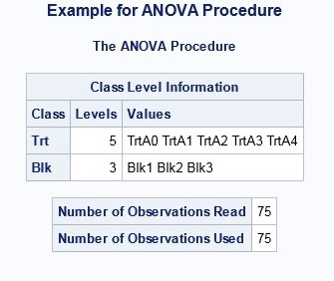
SAS presents the information of
Classification variables which are listed in the
CLASS statement.
Number of observations in the data set used and
the numbers of observation used in the analysis.

Slide 31
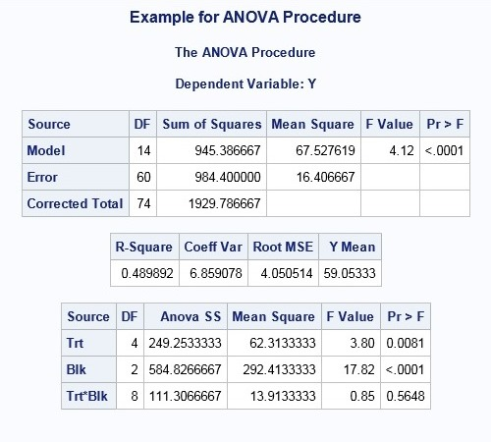
Giving level of significance 0.05, we fail to reject null hypothesis H₀: There is no interaction effect between Trt and Blk.

Slide 32
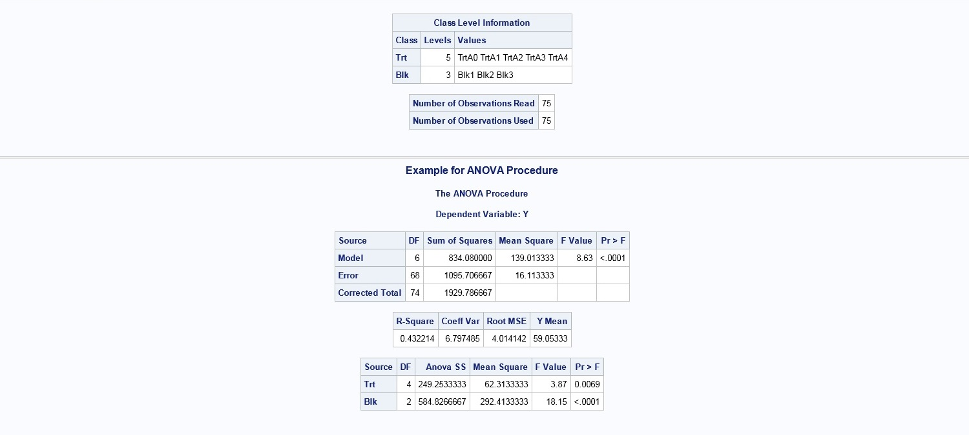
At 0.05 l.o.s., we reject H₀: There is no Trt effect. This means at least one level of Trt is significantly different from the other levels of Trt.
At 0.05 l.o.s., we reject H₀: There is no Blk effect. This means at least one level of Blk is significantly different from the other levels of Blk.

Slide 33
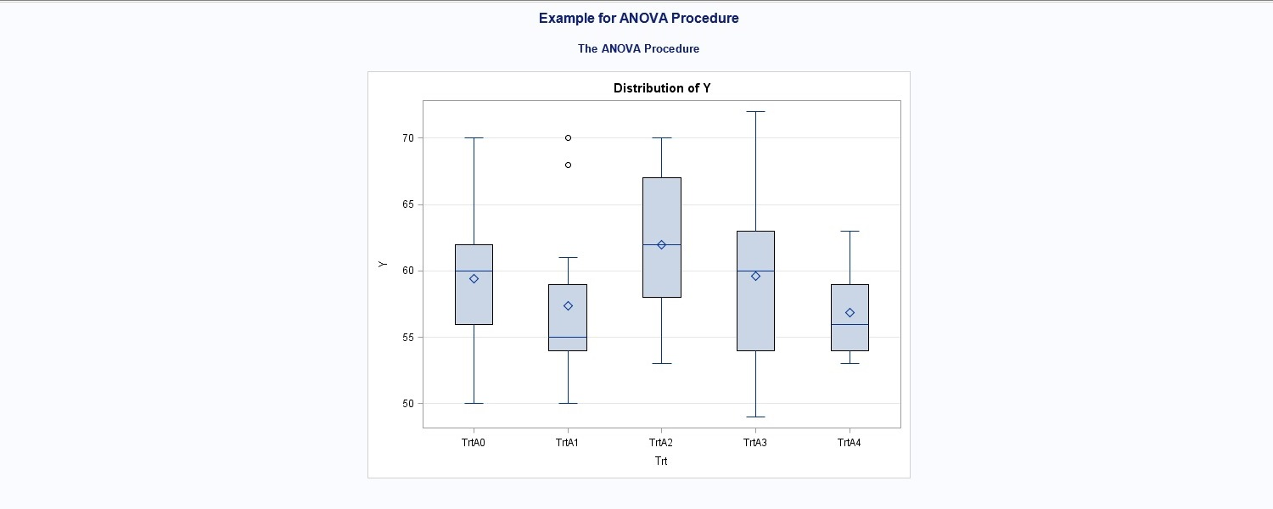
Box-Plots for each level of Trt

Slide 34
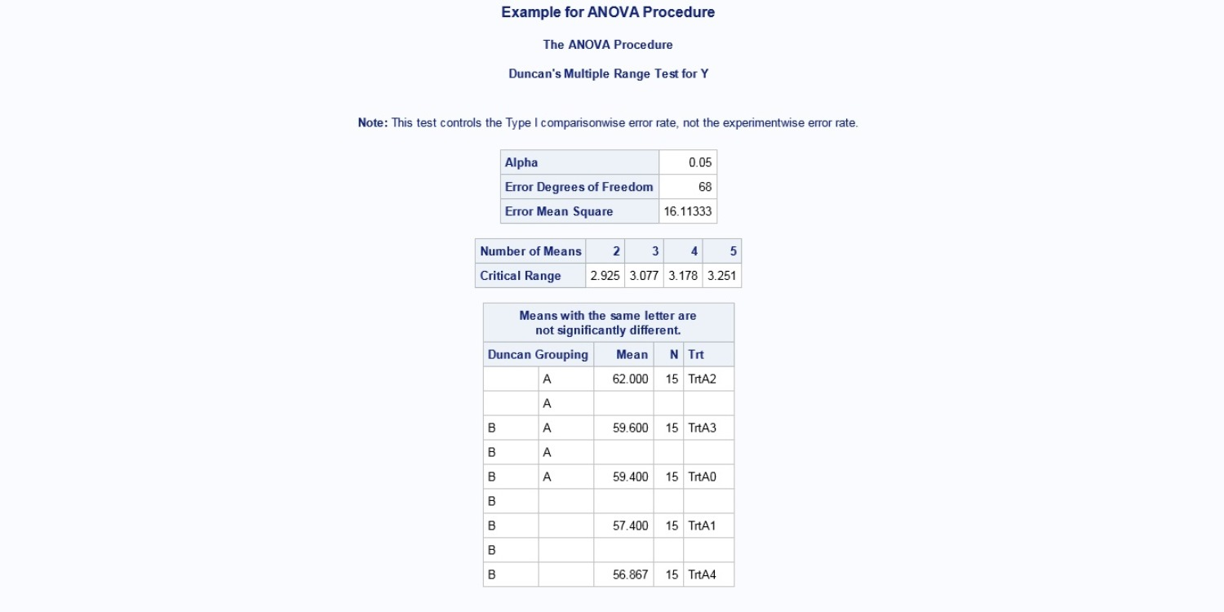
TrtA2, TrtA3, and TrtA0 are not significantly different.
TrtA3, TrtA0, TrtA1 and TrtA4 are not significantly different.
Therefore, TrtA2 is significantly different from TrtA1 and TrtA2 is significantly different from TrtA4

Slide 35
Example 2
DATA LATIN;
DO COL=1 TO 4;
DO ROW=1 TO 4;
INPUT ST $ NI @;
OUTPUT;
END;
END;
CARDS;
K1 19.4 K2 32.6 K3 27.0 K4 20.1
K2 17.7 K3 28.6 K4 27.8 K1 17.9
K3 17.0 K4 19.4 K1 9.1 K2 14.6
K4 20.7 K1 21.0 K2 20.5 K3 20.6
PROC ANOVA DATA=LATIN OUTSTAT=a;
CLASS COL ROW ST;
MODEL NI = COL ROW ST;
MEANS COL / SCHEFFE;
TITLE 'Analysis of Variance for Latin-Square Design';
RUN;

Slide 36
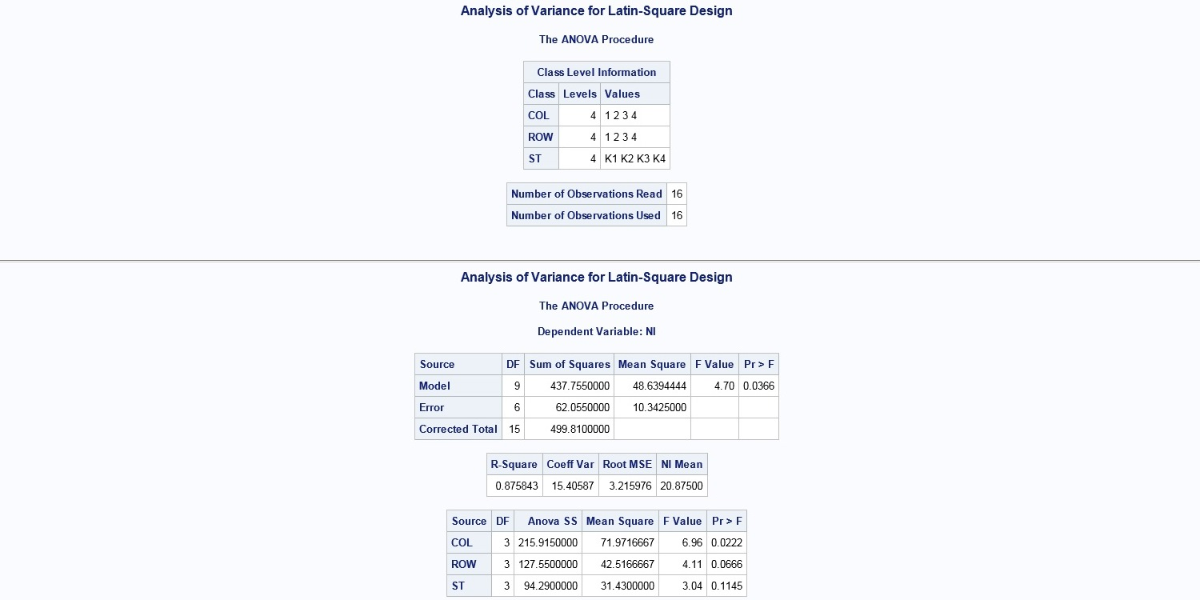

Slide 37
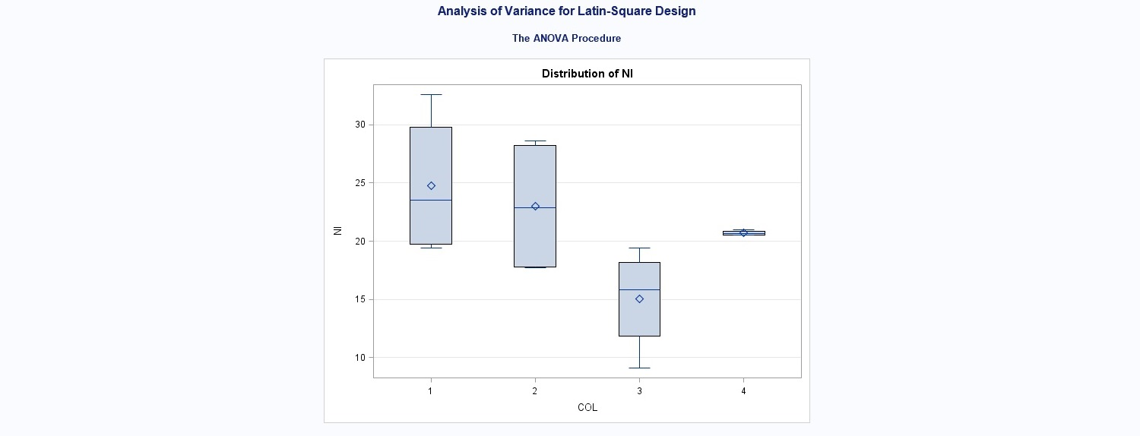

Slide 38
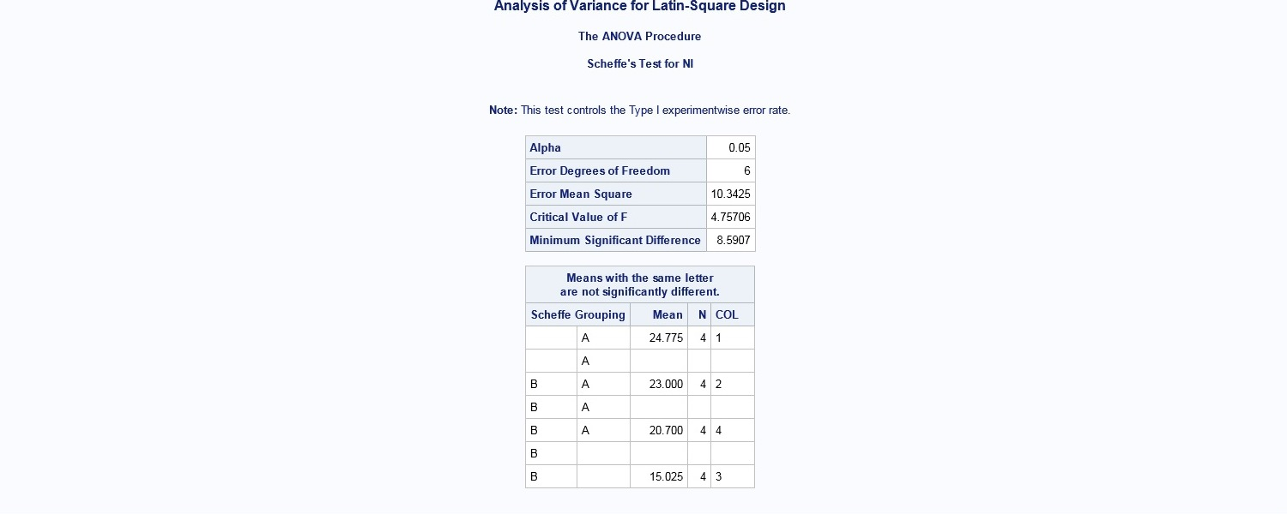
Col₁ is significantly different from Col₃

Slide 39
Referring to the following SAS data set AOV, find the errors in the following statements:
DATA AOV;
INPUT X Y TRTA $ TRTB $ TRTC $;
CARDS;
12 34 A1 B1 C1
13 32 A1 B1 C2
: : : : :
: : : : :
PROC ANOVA DATA=AOV;
MODEL Y = TRTA TRTB;
PROC ANOVA DATA=AOV;
CLASS TRTA TRTB;
MODEL Y = TRTA TRTB;

Slide 40
Referring to the following SAS data set AOV, find the errors in the following statements:
DATA AOV;
INPUT X Y TRTA $ TRTB $ TRTC $;
CARDS;
12 34 A1 B1 C1
13 32 A1 B1 C2
: : : : :
: : : : :
PROC ANOVA DATA=AOV;
CLASSES TRTA TRTB;
MODEL X Y = TRTA TRTB TRTA*TRTB TRTA*TRTC;
PROC ANOVA DATA=AOV;
CLASSES TRTA TRTB TRTC;
MODEL X Y = TRTA TRTB TRTA*TRTB TRTA*TRTC;

Slide 41
Referring to the following SAS data set AOV, find the errors in the following statements:
DATA AOV;
INPUT X Y TRTA $ TRTB $ TRTC $;
CARDS;
12 34 A1 B1 C1
13 32 A1 B1 C2
: : : : :
: : : : :
PROC ANOVA DATA=AOV;
CLASSES TRTA TRTB;
MEANS TRTA TRTB;
PROC ANOVA DATA=AOV;
CLASSES TRTA TRTB;
MODEL X = TRTA TRTB;
MEANS TRTA TRTB;

Slide 42
Referring to the following SAS data set AOV, find the errors in the following statements:
DATA AOV;
INPUT X Y TRTA $ TRTB $ TRTC $;
CARDS;
12 34 A1 B1 C1
13 32 A1 B1 C2
: : : : :
: : : : :
PROC ANOVA DATA=AOV;
CLASSES TRTA TRTB TRTC;
MODEL X = TRTA TRTB;
MODEL Y = TRTA³TRTC;
PROC ANOVA DATA=AOV;
CLASSES TRTA TRTB;
MODEL X = TRTA TRTB;
PROC ANOVA DATA=AOV;
CLASSES TRTA TRTC;
MODEL Y = TRTA TRTC;

Slide 43
Referring to the following SAS data set AOV, find the errors in the following statements:
DATA AOV;
INPUT X Y TRTA $ TRTB $ TRTC $;
CARDS;
12 34 A1 B1 C1
13 32 A1 B1 C2
: : : : :
: : : : :
PROC ANOVA DATA=AOV;
CLASSES TRTA TRTB TRTC;
MODEL Y= TRTA TRTB TRTC;
MEANS TRTA TRTA*TRTC;
TEST H=TRTA E=TRTA*TRTC;
PROC ANOVA DATA=AOV;
CLASSES TRTA TRTB TRTC;
MODEL Y= TRTA TRTB TRTC
TRTA*TRTC;
MEANS TRTA;
TEST H=TRTA E=TRTA*TRTC;

Slide 44
Referring to the following SAS data set AOV, find the errors in the following statements:
DATA AOV;
INPUT X Y TRTA $ TRTB $ TRTC $;
CARDS;
12 34 A1 B1 C1
13 32 A1 B1 C2
: : : : :
: : : : :
PROC ANOVA DATA=AOV;
CLASSES TRTA TRTB TRTC;
MODEL Y = TRTA TRTB TRTC X;
TEST H = TRTA ;
PROC ANOVA DATA=AOV;
CLASSES TRTA TRTB TRTC;
MODEL Y = TRTA TRTB TRTC;
TEST H = TRTA ;

